Slide 1
BRONCHIAL ASTHMA
KISUMU KMTC
CLASS OF SEPTEMBER 2021
PRESENTER; PATRICK OKAMO

Slide 2
Definition
Bronchial asthma is a chronic inflammatory disease of airways characterized by reversible airway obstruction, increased airway responsiveness to a variety of stimuli, mucosal edema and mucus production.

Slide 3
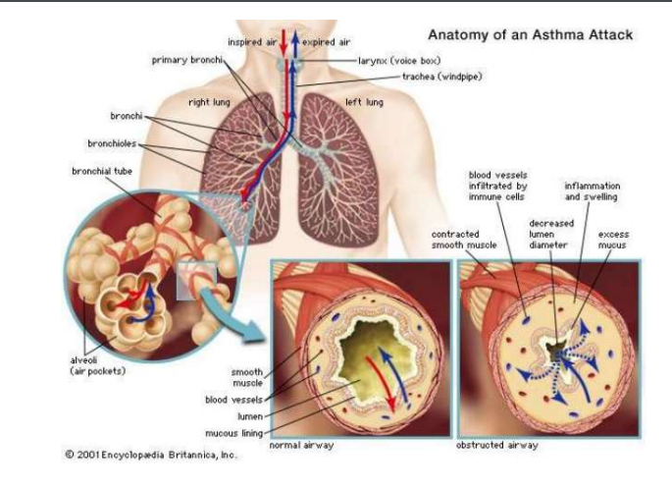

Slide 4
Risk factors
Genetics
Female gender
Obesity
Race
Exposure to respiratory infections while young
Exposure to allergens at tender age

Slide 5
Risk factors
Air pollution
Tobacco smoking

Slide 6
Asthma triggers
Allergens
Air Pollutants
Respiratory infections
Exercise and hyperventilation
Weather changes
Gases like Sulfur dioxide
Food, additives, drugs

Slide 7
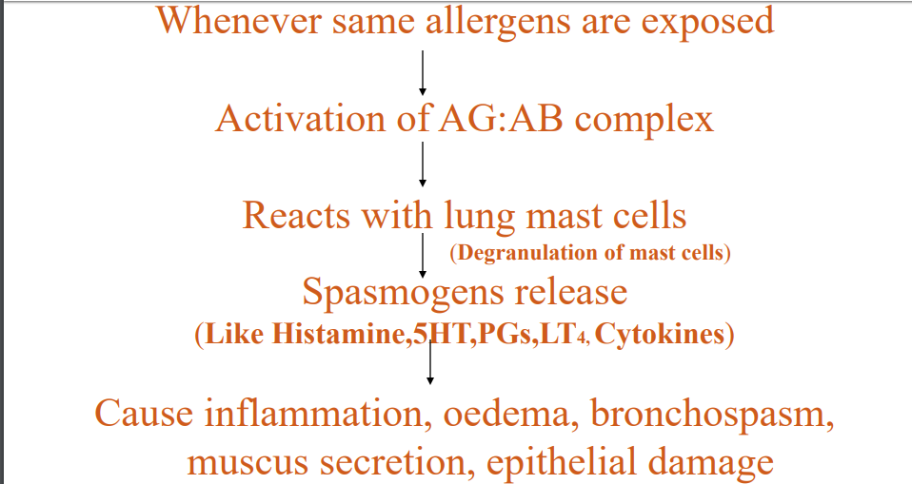
Pathophysiology

Slide 8
Signs and Symptoms
Coughing
Wheezing
Tightness in the chest
Shortness of breath
Tachycardia
Diaphoresis
Central cyanosis

Slide 9
Assessment and diagnosis
History taking
Physical examination
Spirometry
Immunofluorescence
Complete blood count
Pulse oximetry
Arterial blood gas analysis

Slide 10
Medical management
Oxygen therapy
Pharmacological management

Slide 11
Nursing management
Assess patients respiratory status
Assess breath sounds
Assess patient level of O2 saturation using pulse oxymeter
Administer medications
Maintain patent airway
Educate on triggers
Provide regular follow-up care

Slide 12
Nursing management
Hydrate the patient
Administer oxygen

Slide 13
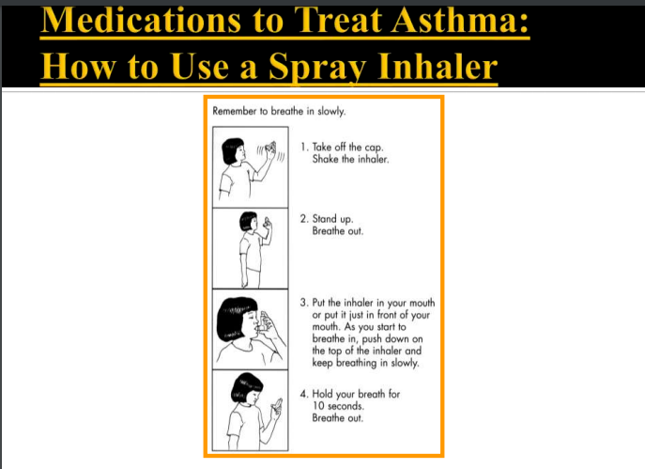

Slide 14
Nursing diagnosis
Impaired gas exchange related to bronchial obstruction as evidenced by cyanosis
Ineffective breathing pattern related to bronchoconstriction as evidence by dyspnea and wheezing.
Ineffective airway clearance related to increased mucus production as evidenced by increased mucus in cough.

Slide 15
Complications
Spontaneous pneumothorax
Status Asthmaticus
Respiratory Failure
Pulmonary Emphysema

Slide 16
References
Suzanne C. Smeltzer, Brenda Bare, Janice L. Hinkle, Kerry H. Cheever (2017): Brunner and Suddarth's Textbook of Medical-Surgical Nursing. 14th Ed. Lippincott Williams &Wilkins

Slide 17
Bronchiectasis

Slide 19
Definition
Bronchiectasis is a chronic, irreversible dilation of the bronchi and bronchioles

Slide 20
Risk factors
Connective tissue diseases eg pulmonary fibrosis
Retained foreign body
Exposure to chemical irritants
Smoking
Respiratory tract infections such as pneumonia
Primary ciliary dyskinesia
Immunodeficiency

Slide 21
Clinical manifestations
Chronic cough
Clubbing
Hemoptysis
Increased pulmonary infection
Wheezing
fatigue

Slide 22
Diagnosis
History taking
Physical examination
Chest Ct scan
Chest X ray

Slide 23
Medical management
Postural drainage
Chest physiotherapy
Smoking cessation
Antimicrobial therapy
Bronchodilators

Slide 24
Nursing managements
Smoking cessation. Patient teaching targets smoking and other factors that increase the production of mucus and hamper its removal.
Bronchodilators. Administer bronchodilators as prescribed.

Slide 25
Nursing Mnx
Postural drainage. Perform postural drainage with percussion and vibration in the morning and at night as prescribed.
Antibiotics. Administer antibiotics as prescribed.
Activities. Encourage alternating activity with rest periods

Slide 26
Nursing management
Nutritional management
Signs of infection
Administer oxygen

Slide 27
Nursing diagnosis
Impaired gas exchange related to ventilation-perfusion imbalance as evidenced by cyanosis,
Ineffective airway clearance related to increased mucus production as evidenced by production of copious mucus production.
Ineffective breathing pattern related to obstruction as evidenced by dyspnea.
Activity intolerance related to hypoxemia and ineffective breathing patterns as evidence patient unable to carry out activities of daily living.

Slide 28
Complications
Empyema
Atelectasis
Pneumonia

Slide 29
Reference
Suzanne C. Smeltzer, Brenda Bare, Janice L. Hinkle, Kerry H. Cheever (2017): Brunner and Suddarth's Textbook of Medical-Surgical Nursing. 14th Ed. Lippincott Williams &Wilkins

Slide 31
BRONCHOGENIC CARCINOMA

Slide 32
DEFINITION
This is malignant neoplasm of the lungs characterized by uncontrolled growth of lung tissue.

Slide 33
Risk factors
Smoking – Both active and passive.
Exposure to radiation or radioactive materials such as uranium
Chemicals such as coal
Exposure to asbestos

Slide 34
Risk factors cont.
Genetics
Age
Breast cancer
Laryngeal cancer
Low vegetable and fruits intake

Slide 35
Signs
Chronic chest pain
Persistent cough
Blood in phlegm
Shortness of breath
Bone pain
Feeling tired
Weight loss and loss of appetite
pneumothorax

Slide 36
Diagnosis
Chest x-ray
CT scan chest
Fine needle biopsy
Positron emission tomography
Bronchoscopy
Thoracoscopy

Slide 37
Medical surgical management
Radiotherapy
Chemotherapy
Surgery- lobectomy, pneumonectomy.
Thoracocentesis

Slide 38
Nursing management
Monitor signs or respiratory failure
Administer medication
Educate patient on progress of condition
Educate on nutrition

Slide 39
Nursing management
Provide psychological support
Prepare for procedures
Analyze laboratory values to rule out neutropenia
Assist with activities of daily living

Slide 40
Nursing diagnosis
Ineffective breathing pattern related reduced lung capacity as evidenced by respiratory distress.
Ineffective airway clearance related to secretions as evidenced by cyanosis
Acute pain related to trauma to lung tissue as evidenced by patient reporting pain

Slide 41
Complications
Anaemia
Pleural effusion
Haemo-pneumothorax

Slide 42
references
Suzanne C. Smeltzer, Brenda Bare, Janice L. Hinkle, Kerry H. Cheever (2017): Brunner and Suddarth's Textbook of Medical-Surgical Nursing. 14th Ed. Lippincott Williams &Wilkins.
Black M.J and Hawks H( 2010) Medical Surgical Nursing 7th Ed.

Slide 44
CHEST INJURY
KMTC KISUMU
DEPARTMENT OF NURSING
PULMONARY NURSING

Slide 45
OBJECTIVES
By the end of the lesson, the learner will be able to:
define chest injury
classify chest injuries
outline various clinical manifestations of chest injuries
outline the diagnosis of chest injury
explain the medical and surgical management of a patient with chest injury
apply the nursing process in management of a patient with chest injury
list complications of chest injuries.

Slide 46
DEFINITION
A chest injury is define as a form of injury to the chest including the ribs, heart and lungs, great vessels, trachea and esophagus.

Slide 47
CLASSIFICATION
Blunt chest injuries
Penetrating chest injuries

Slide 48
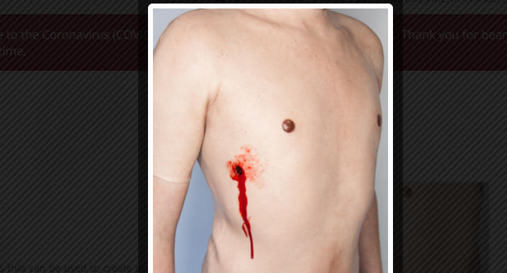
Penetrating chest injuries

Slide 49
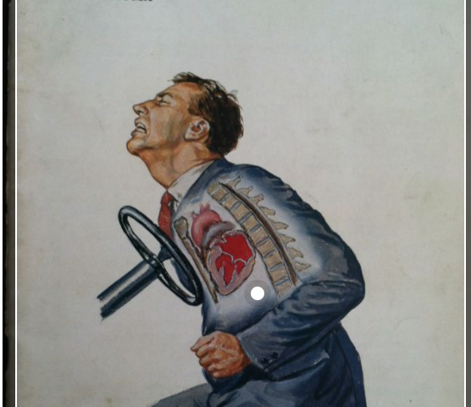
Blunt chest injuries

Slide 50
Causes of blunt trauma injuries
Motor vehicle accident
Pedestrian accident
Fall
Sports injury
Assault with blunt object or Altercations
Crush injury
Explosion

Slide 51
Causes of penetrating trauma injuries
Gunshot
Stab wounds

Slide 52
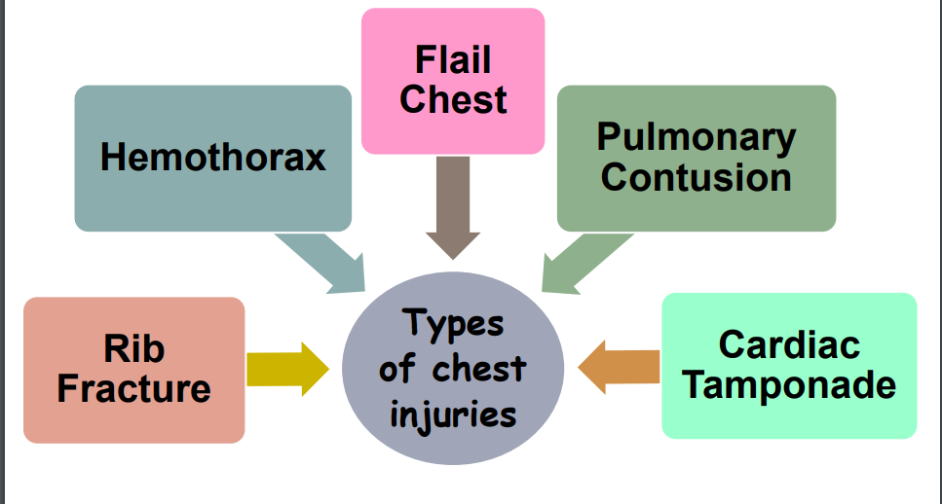
TYPES OF CHEST INJURIES

Slide 53
Clinical manifestations
Dyspnea, respiratory distress
Cough with or without haemoptysis
Cyanosis of mouth, face, nail beds, mucous membranes
Tracheal deviation

Slide 54
Ssx. Cont.
Audible air escaping from chest wound
Decreased breath sounds on side of injury
Decreased Oxygen saturation
Fracture ribs

Slide 55
Clinical manifestations ct
Rapid pulse
Fracture sternum
Decreased BP
Narrowed pulse pressure
Asymmetric BP values in arms
Muffled heart sounds
Tracheal deviation
Cyanosis

Slide 56
Clinical manifestations
Chest pain
Tachycardia
Open chest wound

Slide 57
Diagnosis
History taking
Focused physical examination
Chest x-rays
Chest CT scans
Arterial blood gases

Slide 58
Medical surgical management
Secure and support the airway as indicated
Administer oxygen as per assessment
Monitor ABG/SpO2 results to determine need for supplemental oxygen, mechanical ventilation.

Slide 59
Med-Surg mnx.
Encourage deep breathing with strong inspiration; give local support to injured area by splinting with hands.
Monitor the arterial blood gases to assess acid base disorders
Assist with thoracentesis to aspirate blood from pleural space, if being done before a chest tube insertion in pneumothorax and haemothorax.

Slide 60
Medical surgical management
Assist with chest tube insertion and set up drainage system for complete and continuous removal of blood and air in the case of haemothorax and pneumothorax.
Monitor the blood pressure to assess possible hemorrhage.
Secure intravenous line for possible fluid resuscitation.

Slide 61
Med-Surg. Mnx.
Obtain urinary output hourly to evaluate tissue perfusion.
Administer diuretics as indicated to reduce edema
Administer analgesics as indicated to reduce pain
Institute ECG monitoring for early detection and treatment of cardiac dysrhythmias.

Slide 62
Nursing Diagnosis
Ineffective breathing pattern related to decreased lung expansion as evidenced by dyspnea.
Ineffective gaseous exchange related to ventilation perfusion mismatch as evidenced low SpO2.

Slide 63
Nursing dx.
Decreased cardiac output related to cardiac tamponade or reduced blood pressure as evidenced by reduced blood pressure.
Fluid volume deficit related to massive hemorrhage as evidenced by reduced blood pressure.
Acute pain related to trauma as evidenced by patient verbalizing pain.

Slide 64
Complications of chest injury
Atelectasis
Aspiration
Pneumonia
Emphysema
Respiratory failure

Slide 65
Reference and further reading
Suzanne C. Smeltzer, Brenda Bare, Janice L. Hinkle, Kerry H. Cheever (2017): Brunner and Suddarth's Textbook of Medical-Surgical Nursing. 14th Ed. Lippincott Williams &Wilkins.
Basavanthappa B.T. (2015). Medical Surgical Nursing 3rd Edition Vol. 1 & 2 New Delhi Health Science Publisher.

Slide 66


Slide 67
CHRONIC OBSTRUCTIVE PULMONARY DISEASE
YEAR 2 SEMESTER 1

Slide 68
DEFINITION
This is disease state characterized by airflow limitation that is not fully reversible
In COPD, the airflow limitation is both progressive and associated with an abnormal inflammatory response of the lungs to noxious particles or gases.

Slide 69
Def. cont.
The inflammatory response occurs throughout the airways, parenchyma, and pulmonary vasculature.
Because of the chronic inflammation and the body’s attempts to repair it, narrowing occurs in the small peripheral airways. Over time, this injury-and-repair process causes scar tissue formation and narrowing of the airway lumen.

Slide 70
Examples
Chronic bronchitis
Emphysema

Slide 71
Chronic bronchitis
Chronic bronchitis, a disease of the airways, is defined as the presence of cough and sputum production for at least 3 months in each of 2 consecutive years.
In many cases, smoke or other environmental pollutants irritate the airways, resulting in hyper-secretion of mucus and inflammation.

Slide 72
Chronic bronchitis
This constant irritation causes the mucus-secreting glands and goblet cells to increase in number, ciliary function is reduced, and more mucus is produced.
The bronchial walls become thickened, the bronchial lumen is narrowed, and mucus may plug the airway
Alveoli adjacent to the bronchioles may become damaged and fibrosed, resulting in altered function of the alveolar macrophages.

Slide 73
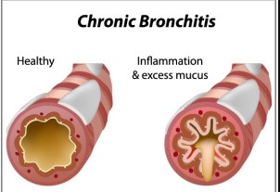

Slide 74
Emphysema
This is abnormal distention of the air spaces beyond the terminal bronchioles, with destruction of the walls of the alveoli.

Slide 75
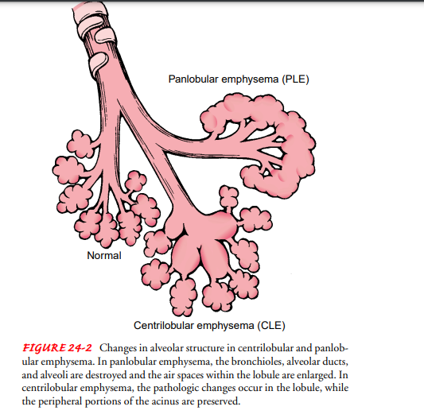

Slide 76
Risk factors
smoking
Occupational exposure
Ambient air pollution
Genetic abnormalities-deficiency of alpha1- antitrypsin

Slide 77
Clinical manifestation
Cough
sputum production
dyspnea on exertion
Unexplained weight loss
Recurrent respiratory infections
Barrel-shaped chest

Slide 78
Clinical features cont.
Prolonged expiration during quiet breathing
Expiration through pursed lips
Assumption of tripod position while breathing
Decreased tactile fremitus
Hyper-resonance

Slide 79
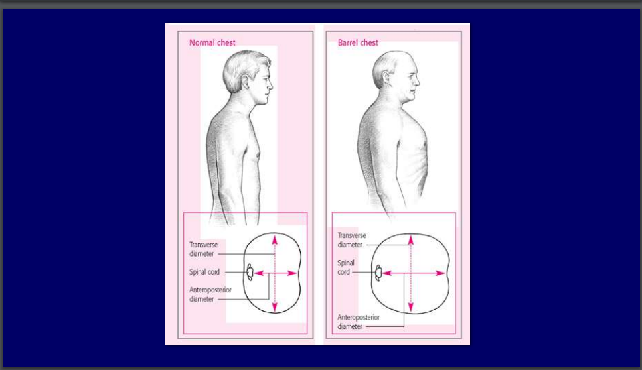

Slide 80
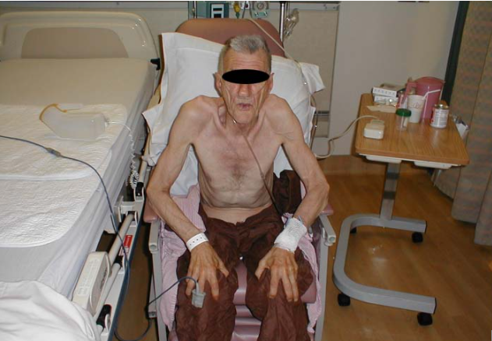
Tripod position

Slide 81
Diagnosis
History taking
Physical examinations
Spirometry
Chest x-ray
Chest CT scan
Arterial blood gases

Slide 82
Medical and surgical management
Risk reduction
Bronchodilators
Corticosteroids
Oxygen therapy
Vaccination
Oxygen therapy
Lung transplantation

Slide 83
Nursing management
Adequately hydrate the patient.
Teach and encourage the use of diaphragmatic breathing and coughing techniques.
Assist in administering nebulizer or MDI.
Instruct patient to avoid bronchial irritants such as cigarette smoke, aerosols, extremes of temperature, and fumes.
Teach early signs of infection that are to be reported to the clinician immediately

Slide 84
Nursing management
Encourage alternating activity with rest periods
Assist with activities of daily living
Nutrition

Slide 86
PLEURISY
KMTC YEAR 2 SEMESTER 1

Slide 87
DEFINITION
Pleurisy (pleuritis) refers to inflammation of both layers of the pleurae (parietal and visceral)

Slide 88
Risk factors
Pneumonia
Upper respiratory tract infection
TB
Collagen disease- Systemic lupus erythromatosus
Trauma to the chest
Pulmonary infarction
Pulmonary embolism

Slide 89
Risk factors
Thoracotomy
Bronchogenic carcinoma
Drugs such as methotrexate

Slide 90
Clinical manifestations
Chest pain that worsens with breathing coughing or sneezing
Shortness of breath
Fever

Slide 91
Diagnosis
History taking
Physical examination-a pleural friction rub can be heard with the stethoscope
Chest x rays
Thoracentesis
Thoracoscopy

Slide 92
Medical management pleurisy
Goal of treatment is to eradicate the aetiology
Antibiotics for bacterial infections.
Antivirals for viral infections.
Analgesics for pain management
Immunosuppressant for autoimmune disorders
Chemotherapy for cancer related cause.

Slide 93
Nursing management
The nurse can offer suggestions to enhance comfort, such as turning frequently onto the affected side to splint the chest wall and reduce the stretching of the pleurae
The nurse also can teach the patient to use the hands or a pillow to splint the rib cage while coughing

Slide 94
Nursing diagnosis
Ineffective breathing pattern related pleuritic pain as evidenced by shortness of breath.
Acute pain related to inflammatory process as evidenced by patient reporting pain.
Hyperthermia related to inflammatory process as evidenced ny elevated body temperature.

Slide 95
references
Suzanne C. Smeltzer, Brenda Bare, Janice L. Hinkle, Kerry H. Cheever (2017): Brunner and Suddarth's Textbook of Medical-Surgical Nursing. 14th Ed. Lippincott Williams &Wilkins

Slide 96
Nursing diagnosis
Impaired gas exchange related to ventilation–perfusion inequality as evidenced by cyanosis
Ineffective breathing pattern related to bronchoconstriction as evidenced by dyspnea.
Activity intolerance RT fatigue as evidenced by inability to carry out activities of daily living.
Imbalanced nutrition related increased metabolism as evidenced ny wasting.

Slide 97
Complications
Pneumothorax
Atelectasis
Bronchogenic carcinoma

Slide 98
References
Suzanne C. Smeltzer, Brenda Bare, Janice L. Hinkle, Kerry H. Cheever (2017): Brunner and Suddarth's Textbook of Medical-Surgical Nursing. 14th Ed. Lippincott Williams &Wilkins

Slide 99
PNEUMOTHORAX
Year 2 Semester 2

Slide 100
OBJECTIVES
By the end of the lecture, the student should be able to;
-define pneumothorax
-outline causes of pneumothorax
-list clinical presentation of pneumothorax

Slide 101
Objectives cont.
- state the methods diagnosis of pneumothorax
- outline medical and surgical management of patient with pneumothorax
- apply the nursing process in management of patient with pneumothorax

Slide 102
objectives
- List complications of pneumothorax

Slide 103
Definition
Pneumothorax is presence of air within the pleural space

Slide 104
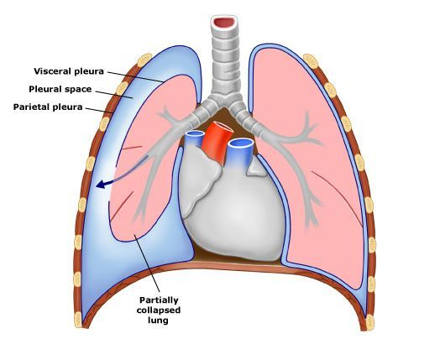

Slide 105
Classification
Spontaneous
Traumatic

Slide 106
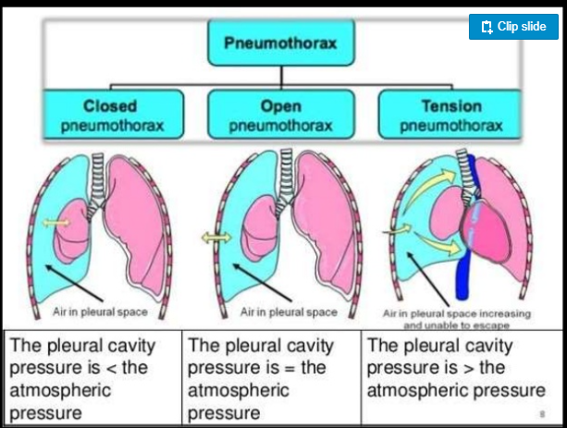
Clinical types

Slide 107
Simple /closed pneumothorax
The opening in the lung is very small and hence, it heals rapidly.
There is no continuous communication between the lung and the pleural cavity.

Slide 108
Open / sucking pneumothorax
The ruptured site remains open and There is a communication between the pleural cavity and the bronchus forming the Broncho-pleural fistula.

Slide 109
Tension pneumothorax
The communication between the lung and pleural cavity is small and is valvular.
It allows air entry during inspiration but prevents it from escaping during expiration.

Slide 110
Risk factors
Spontaneous
-Smoking
-TB
-COPD
-Bronchogenic carcinoma
-Asthma
-Cystic lung disease

Slide 111
Traumatic
Related to cardiothoracic surgeries
Chest trauma

Slide 112
Signs
Dyspnea
Accessory muscles of respiration
Shift of trachea
Shift of mediastinum to opposite side

Slide 113
Signs
Fullness of chest on the affected side
Diminished chest movements
Marked diminished vocal fremitus on affected side
Reduction in total chest expansion
Hyper-resonant on affected pneumothorax
Diminished to absent breath sounds

Slide 114
Diagnosis
History taking
Physical examination
Chest x ray
Chest CT scan

Slide 115
Medical surgical management
Oxygen administration
Simple aspiration
Intercostal tube drainage

Slide 116
Nursing diagnosis
Ineffective breathing pattern related to decreased lung expansion as evidenced by use of accessory respiratory muscles.
Impaired gaseous exchange related to decreased oxygen diffusion capacity as evidenced by cyanosis.
Acute pain related to trauma to soft tissue as evidenced by patient verbalizing pain.

Slide 117
Complication
Hydropneumothorax
Pyopneumothorax
Haemopneumothorax
Emphysema

Slide 118
References
Suzanne C. Smeltzer, Brenda Bare, Janice L. Hinkle, Kerry H. Cheever (2017): Brunner and Suddarth's Textbook of Medical-Surgical Nursing. 14th Ed. Lippincott Williams &Wilkins.
Basavanthappa B.T. (2015). Medical Surgical Nursing 3rd Edition Vol. 1 & 2 New Delhi Health Science Publisher.

Slide 119
STATUS ASTHMATICUS
YEAR TWO SEMESTER ONE
DEPARTMENT OF GENERAL NURSING.
PULMONARY NURSING

Slide 120
OBJECTIVES
By the end of the lesson the learner should be able to;
-define status asthmaticus
-describe the pathophysiology of status asthmatus
-list the risk factors to status asthmaticus
-outline the clinical manifestations of status asthmaticus
-describe the diagnosis of status asthmaticus

Slide 121
Objectives continuation
- Outline the medical and surgical management of status asthmaticus.
- Apply the nursing process in management of status asthmaticus.
- List complications of status asthmaticus.

Slide 122
Definition
Status asthmaticus is severe and persistent asthma that does not respond to conventional therapy

Slide 123
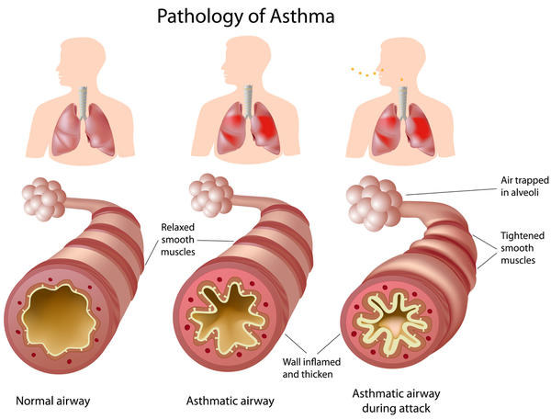

Slide 124
Pathophysiology
Acute bronchoconstriction
↓
Airway edema
↓
Mucus production
↓
Airway remodeling

Slide 125
Risk factors to status asthmaticus
Infection
Anxiety
nebulizer abuse
Dehydration

Slide 126
Risk factors cont.
Allergens
History of syncope or seizures during acute exacerbation
Oxygen saturation below 92% despite supplemental oxygen

Slide 127
Clinical manifestations
Labored breathing
Prolonged exhalation
Engorged neck veins
Wheezing.

Slide 128
Clinical manifestations
Diminished breath sounds
Tachypnea
Impaired mental functioning.
Tachycardia

Slide 129
Diagnosis
History taking
Physical examination
Arterial blood gas analysis
Pulse oximetry
Pulmonary function tests

Slide 130
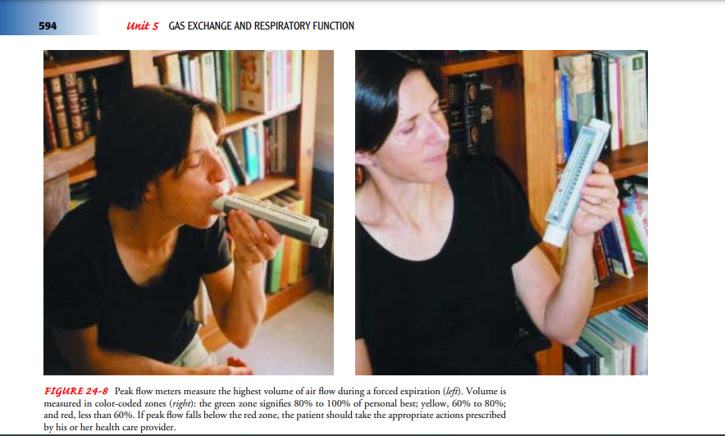
Peak flow meter

Slide 131
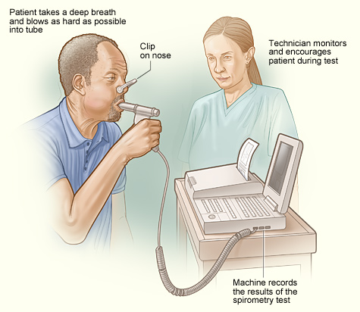
Spirometry

Slide 132
Medical management
Oxygen therapy
Pharmacological management
Fluid therapy
Mechanical ventilation

Slide 133
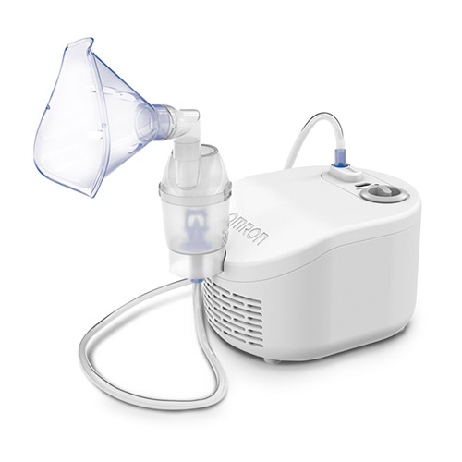
Nebulizer

Slide 134
Nursing management
Place the patient on a sitting position
Administer oxygen
Administer medication
Provide psychological support
Place patient in a room free from respiratory irritants
Provide bed rest

Slide 135
Nursing diagnosis
Impaired gas exchange related to ventilation–perfusion inequality as evidenced by central cyanosis and change in mental status.
Ineffective breathing pattern related to increased mucus production as evidenced by dyspnea

Slide 136
Nursing Dx. Cont.
Ineffective airway clearance related to increased mucus production as evidenced by increased mucus in cough
Activity intolerance related to fatigue as evidenced by patient inability to carry out activities of daily living.

Slide 137
Complications
Spontaneous pneumothorax
Respiratory failure
Heart failure
Hypoxic brain injury
Myocardial infarction

Slide 138
Assignment
Using three priority nursing diagnosis write a nursing care plan for a patient with status asthmaticus.

Slide 139
References
Hinkle,L., & Cheever, H. (2018). Brunner & Suddarth's textbook of medical-surgical nursing (Edition 14.). Wolters Kluwer Health/Lippincott Williams & Wilkins
Basavanthappa, T. (2015). Medical Surgical Nursing 3rd Edition Vol. 1 & 2 New Delhi Health Science Publisher
American Lung Association, 1740 Broadway, New York, NY 10019- 4374; (212) 315-8700; http://www.lungusa.org.

Slide 140
BRONCHIOLITIS

Slide 141
Bronchiolitis
What is it?
Acute infectious inflammatory disease of the URTI
Lower respiratory tract infection- obstruction of small airways
Infants less than 1 year- severe resp. symptoms due to mucosal oedema. (Boys affected > girls)
Leads to air trapping airway obstruction
Respiratory Syncytial Virus bronchiolitis highly contagious
Most causes are self limiting

Slide 142
Cont.
Two RSV subtypes A (severe) and B (Structural variations in the G protein)
Viral shedding in nasal secretions for 6-21 days after symptoms develop.
Complex immunologic mechanisms play a role in RSV bronchiolitis. Type 1 allergic reactions mediated by IgE antibody account for significant bronchiolitis thus breastfed babies (Colostrum-IgA) relatively protected

Slide 143
Risk factors
Low birth weight
Lower socio-economic group
Parental smoking
Crowded condition, day care
Chronic lung disease
CHD + pulmonary hypertension
<3 months old

Slide 144
Diagnosis/Clinical Manifestation
Nasal obstruction
Runny nose
Cough
Fever cough
Apnoea (particularly neonates)

Slide 145
Clinical Manifestation
Respiratory Distress
Mild Clinical Signs
Moderate
Severe
Greatest risk
Very young
Prem/LBW
Underlying heart/lung problems

Slide 146
Ssx. Cont.
Coryza – Rhinorrhea, fever
Sharp, Dry cough
Wheezing
Fine inspiratory crackles
Progressive breathlessness

Slide 147
Respiratory Distress (contd)
Rapid, hard and fast breathing. (Very important clinical finding).
Tug/recession
Cyanosis
Flaring
Grunt

Slide 148
Diagnostic Tests
Nil specific
Consider
Naso-Pharyngeal Airway for respiratory viruses – RSA antigen
CXR- Hyperinflated lung due to airways obstruction air trapping, focal atelectasis)
FBC - Lymphocytosis
Blood Culture
ABG- < arterial O2, > CO2 tension
NONE are routine

Slide 149
Differential DX
Pertussis (Bronchitis)
Pneumonia CXR, ? Fever, toxic
Asthma, family hx, no fever, bronchodilator response, older children
Heart Failure ? HR, murmurs, Enlarged liver
Pneumothorax CXR, deviated trachea
Foreign Body hx, choking, unilateral signs
Aspiration syndrome

Slide 150
Mild Bronchiolitis
Feeding normally
Little respiratory distress
Fever less than 385C (50)
No O2 requirements
? D/C home

Slide 151
Moderate Bronchiolitis
SOB, poor feeding
Moderate respiratory distress
Short, self limiting Apnoeas
Need O2 to keep sats gt 95
Fever
? admit, Paediatrician where possible
O2, IV fluids
Observation sats NB
NPA CXR

Slide 152
Severe Bronchiolitis
Unable to feed
Severe respiratory distress
Tiring! Frequent prolonged Apnoea
Maximum O2 UNABLE to keep sats up
Fever
NBM, IV fluids
CXR, ABG
Monitor, intubate, ventilate

Slide 153
Management
Supportive (Viral) provide adequate fluid (N/G, I.V) to maintain hydration
Monitor for apnea (Infants)
Humidified O2 via nasal cannula determined by pulse oximetry
Mist, antibiotics
Nebulized bronchodilator (Salbutamol/Ipatropium
Good hand hygiene and monoclonal antibody prophylaxis (i.m palivizumab)

Slide 154
Prognosis
Recovery within two weeks
Half will have recurrent cough + wheeze
Following Adenovirus infection> permanent airways damage (Bronchiolitis obliterans)

